Slide 1

Inappropriate Comments Scanner
Adithya Singh (217Z1A6702)
Ch. Harini Reddy (217Z1A6713)
N.Hema Narendra Reddy (217Z1A6743)
CSE-Data Science
GUIDE NAME
Mr. S. Ravi Teja

Slide 2


OVERVIEW
Abstract
Existing System
Proposed System
Algorithms
Flowchart
Design
Modules
Conclusion

Slide 3



ABSTRACT
Problem Statement: Traditional methods for filtering inappropriate comments rely on static keyword-based approaches, leading to inefficiencies.
Solution: AI-powered classification using Bidirectional LSTM and TextVectorization improves accuracy and real-time adaptability.
Benefits: Efficient detection, scalability, real-time moderation, and context-aware filtering.

Slide 4



EXISTING SYSTEM
Manual Moderation: Requires human effort, time-consuming, and inconsistent.
Keyword-Based Filtering: Ineffective against context-based toxicity and leads to false positives.
Limitations: Lacks adaptability, poor handling of evolving slang and nuanced language.

Slide 5



PROPOSED SYSTEM
AI-Based Classification: Uses LSTM with optimized data pipelines for efficient comment classification.
Real-Time Processing: Deployable on cloud platforms for scalable performance.
Improved Accuracy: Robust training with labeled datasets ensures precise classification.

Slide 6
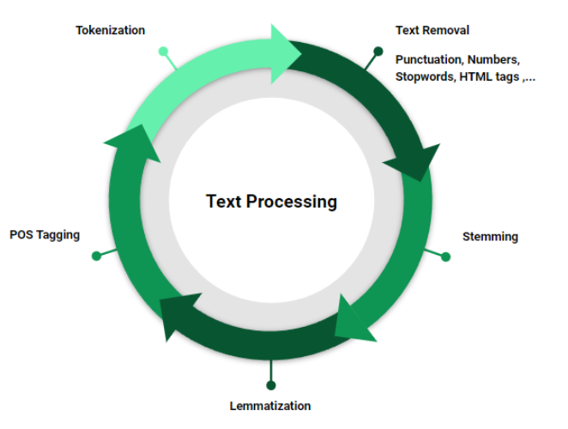
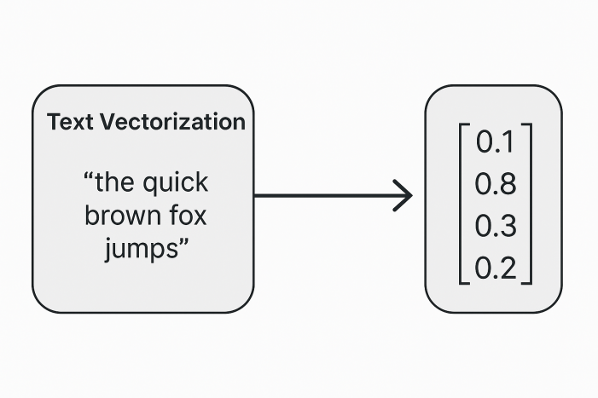
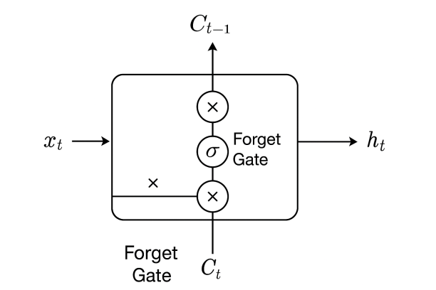
ALGORITHMS
Bidirectional LSTM: Captures context from both previous and upcoming words, improving classification.
TextVectorization: Converts text into numerical data for efficient processing.
Preprocessing Techniques: Tokenization, stopword removal, and normalization enhance accuracy.

Slide 7
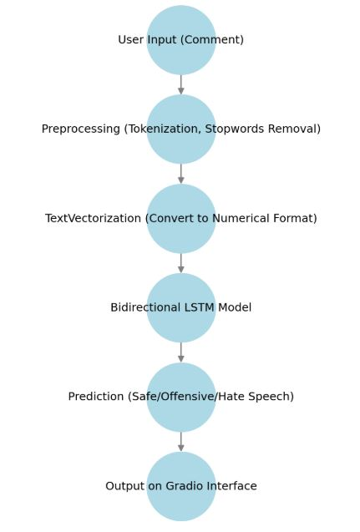
FLOWCHART

Slide 8






DESIGN
Frontend
(Gradio UI)
Backend
(Python, TensorFlow)
USER
Database
(MySQL, MongoDB)
API
(REST API, JSON)
Cloud Services
(AWS, Google Cloud)

Slide 9






MODULES
Data Collection & Preprocessing
Inference & API
User Interface (Gradio)
Database (MySQL, MongoDB)
Model Training & Optimization

Slide 10



CONCLUSION
Key Achievements: Efficient and scalable AI-based moderation.
Performance Enhancements: LSTM + TextVectorization improve accuracy.
Future Scope: Integration with social media platforms, multilingual support, and improved contextual understanding.

Slide 11
THANK YOU

